Slide 1
What is the photovoice method?
Professor Athina Vlachantoni
Centre for Research on Ageing and ESRC Centre for Population Change

Slide 2

The research project
“Promoting inclusivity in pension protection and other forms of saving among men and women from black and minority ethnic communities in the UK: a mixed methods study”
Funded by the ESRC’s Inclusive Ageing call
Financial resilience for later life
Statistical analysis of national data
Photo-voice and interviews with older persons
Engagement with local community
Engagement with local and national policymakers

Slide 3

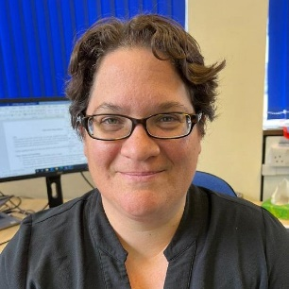
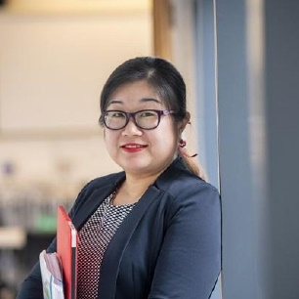
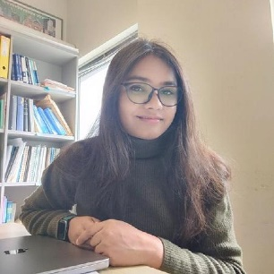
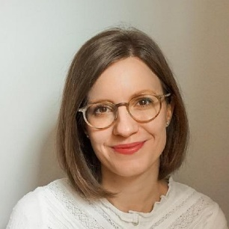
The research team
PROF ATHINA VLACHANTONI, Centre for research on ageing, social sciences
PROF YUANYUAN YIN, winchester school of art
DR SADDAF NAAZ AKHTAR, centre for research on ageing, social sciences
DR SPELA MOCNIK, centre for research on ageing, social sciences

Slide 4
Photovoice as a methodology
Sometimes described as ‘photo elicitation’ – emphasis on eliciting insights from participants (Pink et al 2011)
Focus on the participant’s ‘voice’ in choosing what photos to take (Castleden et al 2008)
Focus on the participant’s ‘voice’ in interpreting the images, the context, the dynamic processes, the constructions of different concepts (Wang and Burris 1997)
Progress into a dialogue between the researcher and the participant which relates to the focus of the research (Winton 2016)
Continuous emphasis on the participant’s worldview/ perspective
Analysis of data using qualitative methods
“Please take photos on topic X”
“Why did you take this photo when thinking of topic X?”
“What are your views on topic X?”

Slide 5
In our project…
Schedule | ACTIVITY | Factors explored
WEEK 1 Financial circumstances and decisions | Think about your typical week and countless financial decisions that you make daily, be it grocery shopping or putting aside money for rainy days. Think about how you spend, budget, and save money and how these decisions impact your life short- and long-term. Take photographs of landscapes/ objects/ people/ situations/ symbols to express what you perceive and experience as financial planning. Take photographs during normal daily routines, in familiar public places and at home. | Household finances
 |  | Budgeting
 |  | Attitudes to money
 |  | Culture, intra-family support
 |  | Earnings
 |  | Current needs and consumption
 |  | Barriers / facilitators of saving
 |  | Awareness and pension knowledge
WEEK 2 COVID-19 and cost of living crisis | Think about your life before the pandemic and think about it now. What are some of the changes (in relation to finances, work and/or savings) that have taken place in your life over the past three years? Try to photograph some of those changes. | Structural factors
 |  | Budgeting
 |  | Current needs and consumption
 |  | Saving priorities
 |  | Earnings
WEEK 3 Retirement | [if retired] How does your everyday life look like? Try to photograph things that you enjoy doing as a retiree and those that are less enjoyable for you. Is this how you imagined your retirement to be? If not, how had you imagined it? [if not yet retired] How would you like your retirement to look like? How do you imagine it will look like? | Awareness and pension knowledge
 |  | Intergenerational, intra-family support
 |  | Culture
 |  | Access to information
 |  | Advice and guidance

Slide 6
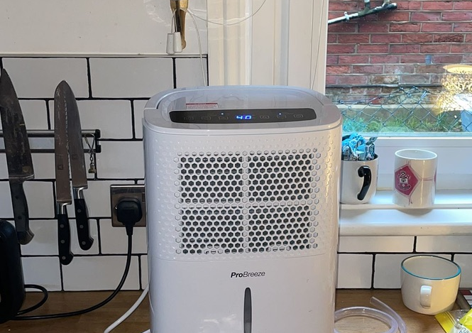
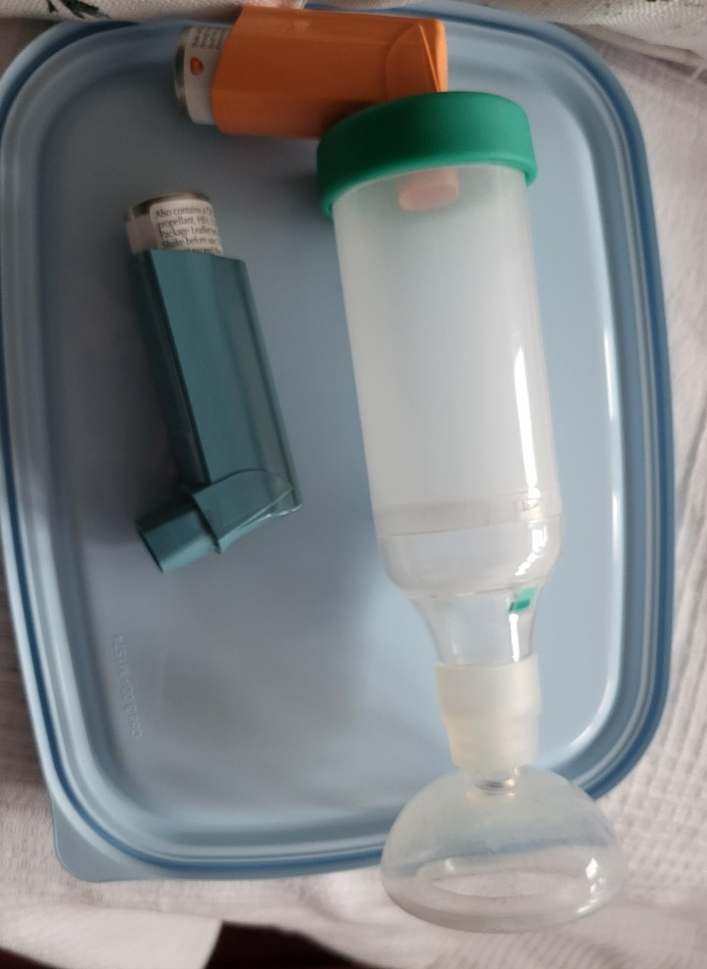
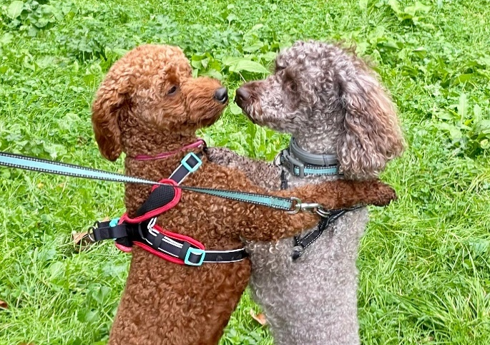
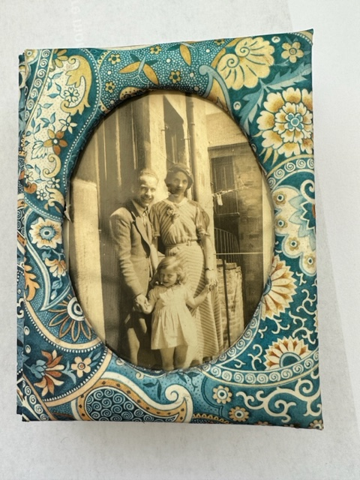

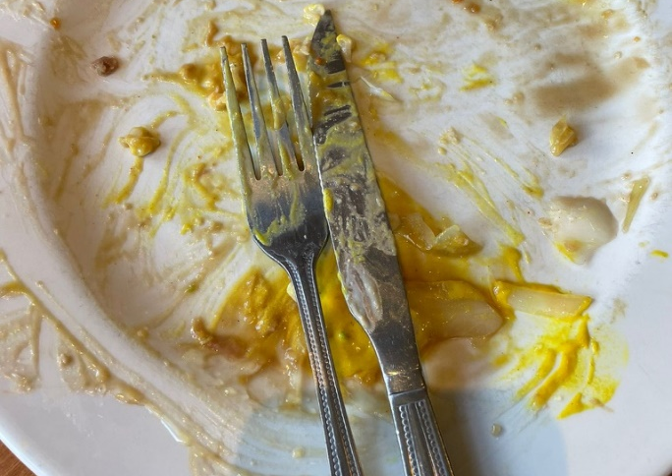
Energy, health, pets, family, expenditure etc etc

Slide 7
Reflections on using the photovoice method
The method really does place the participant at the heart of the investigation → even more important for research on under-represented groups
Creative method → “a picture is a thousand words” – very useful for a topic like financial resilience where sensitive aspects might be difficult to convey or initiate a conversation on
Method open to diversity → how do individuals with diverse characteristics, background, religion, etc. talk about finances?
Method open to interdisciplinarity → ideal for multidisciplinary research team where different concepts, narratives, ways of talking about topics are embedded
“One of our clients who needs advice on debt has a massive amount of savings for his daughter’s wedding”
“So he is not really in debt?”
“Oh yes he is. He can’t use those savings on anything else”
Challenges: categorisation, interpretation, making sense of immense diversity

Slide 8

Some useful references
Castleden H, Garvin T; Huu-ay-aht First Nation. Modifying Photovoice for community-based participatory Indigenous research. Soc Sci Med. 2008 Mar;66(6):1393-405.
Gaver, W., Dunne, T. and Pacenti, E. 1999. Cultural Probes. Interactions, 6, 1, 21-9.
Pink, S. (2011) ‘Images, Senses And Applications: Engaging Visual Anthropology’, Visual Anthropology, 24(5): 437-454
Wang C, Burris MA. Photovoice: concept, methodology, and use for participatory needs assessment. Health Educ Behav. 1997 Jun;24(3):369-87.
Winton, A. (2016). Using photography as a creative, collaborative research tool. Qualitative Report, 21(2), 428–449.

