Slide 1
"What is?"
“How To Distinguish Academic
Inquiry From Journalistic Investigation“
Exploring the Key Differences in Purpose, Evidence, and Style
University of Portsmouth
Area Studies
SCTDP
Rachid Sekkai
PhD Candidate
26/11/24

Slide 2
How to SPOT the Differences?

Slide 3
Exercice: Which Question is Academic and Which is Journalistic?
1. How do Trump’s foreign policy goals align with realist and liberalist paradigms in international relations theory?
2. Does Trump have a specific timeline to end global wars?
3. What are the structural and systemic barriers to achieving world peace?
4. What steps has Trump taken so far toward ending ongoing conflicts?
5. How have historical precedents of similar political promises fared in achieving global peace?
6. How are international leaders responding to Trump’s peace proposals?
________________________________________
Please answer A for Academic and B for Journalistic in the chat.

Slide 4
What is Academic Inquiry/ Research?
Booth, W. C., Colomb, G. G., & Williams, J. M. The Craft of Research (2008)
"A process of gathering information from sources to answer a question and thereby help solve a problem.“
- Research is a deliberate process of gathering and analysing information to answer a specific question and solve a problem, contributing to knowledge.
- It involves formulating clear questions, systematically seeking evidence, and critically engaging with sources to construct meaningful insights.

Slide 5
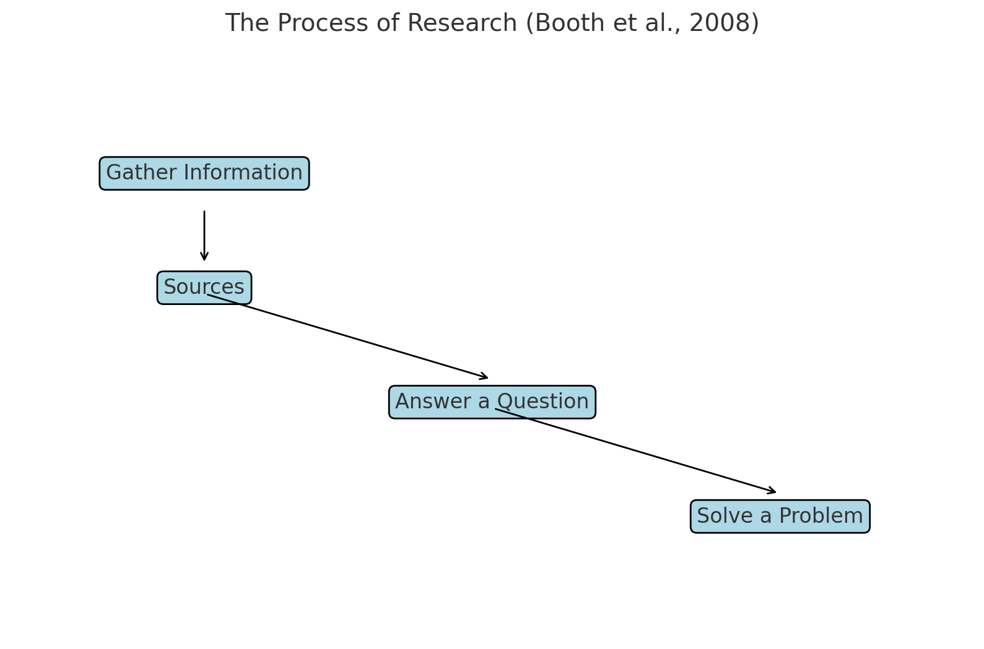

Slide 6
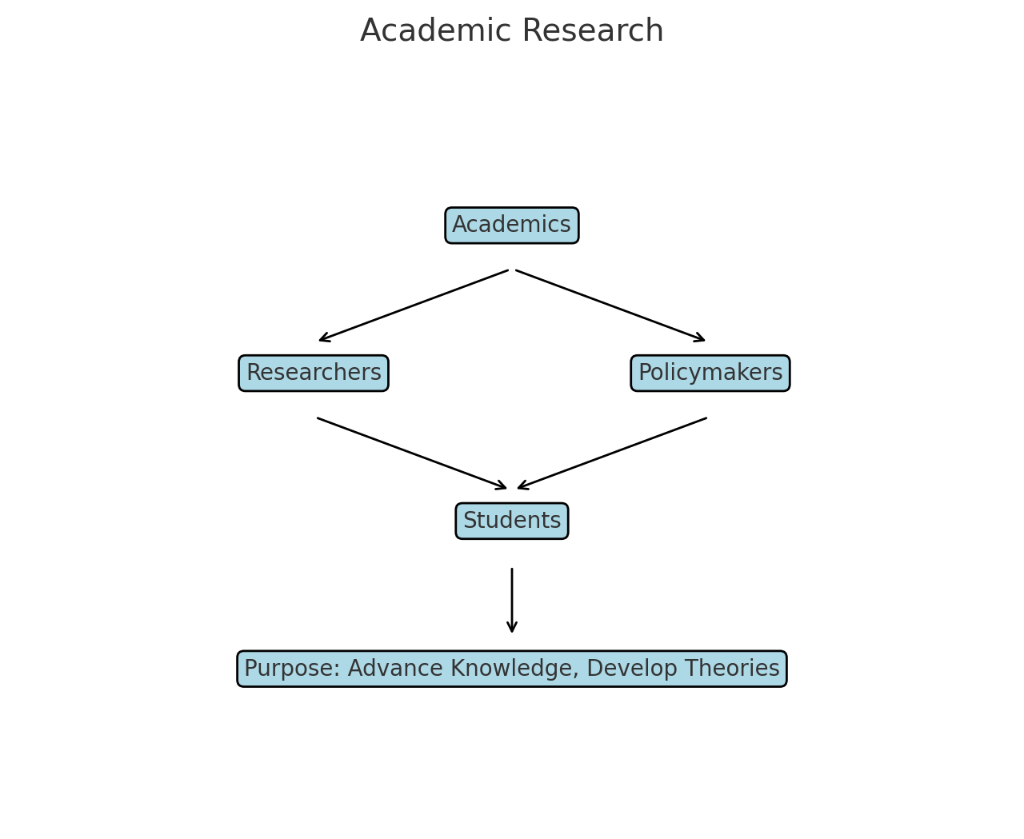

Slide 7
What is Journalistic Investigation?
Kovach, B., & Rosenstiel, T. in The Elements of Journalism (2021)
"The discipline of verification, committed to providing citizens with the accurate and reliable information they need to function in a free society."
Ensuring the accuracy of information, maintaining a commitment to truth, and…
Serving the public interest by empowering informed decision-making in democratic societies.

Slide 8
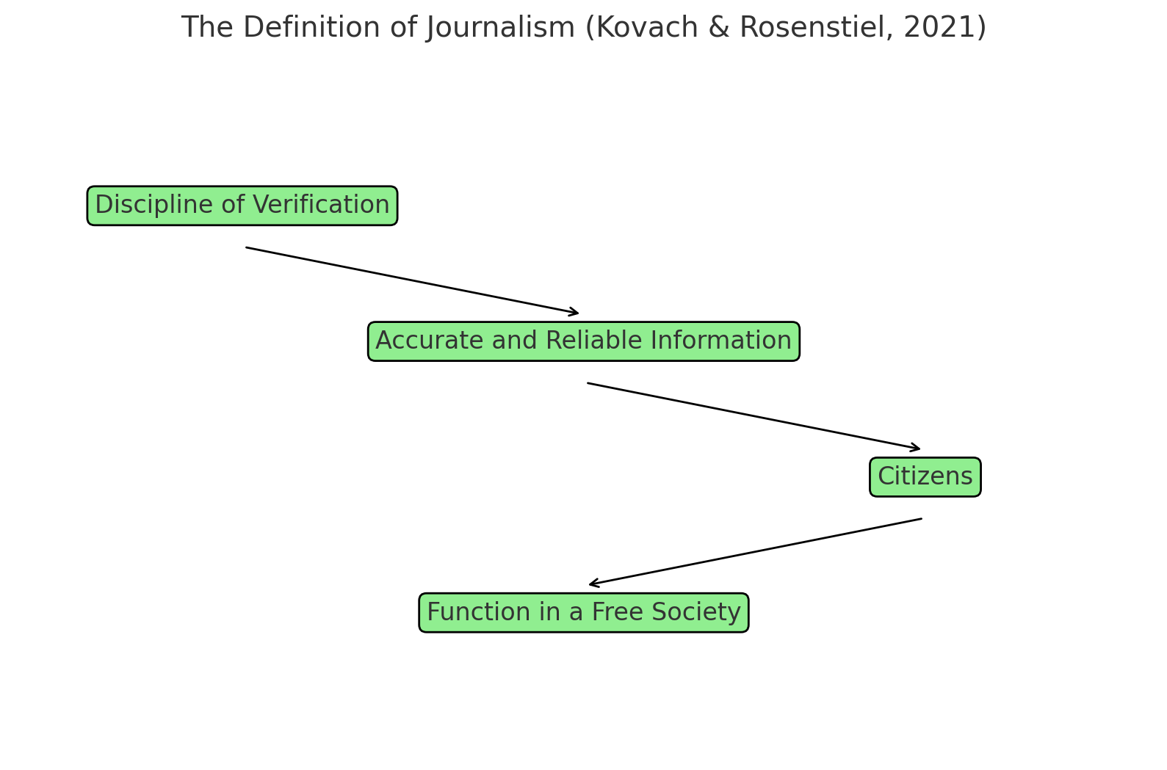

Slide 9
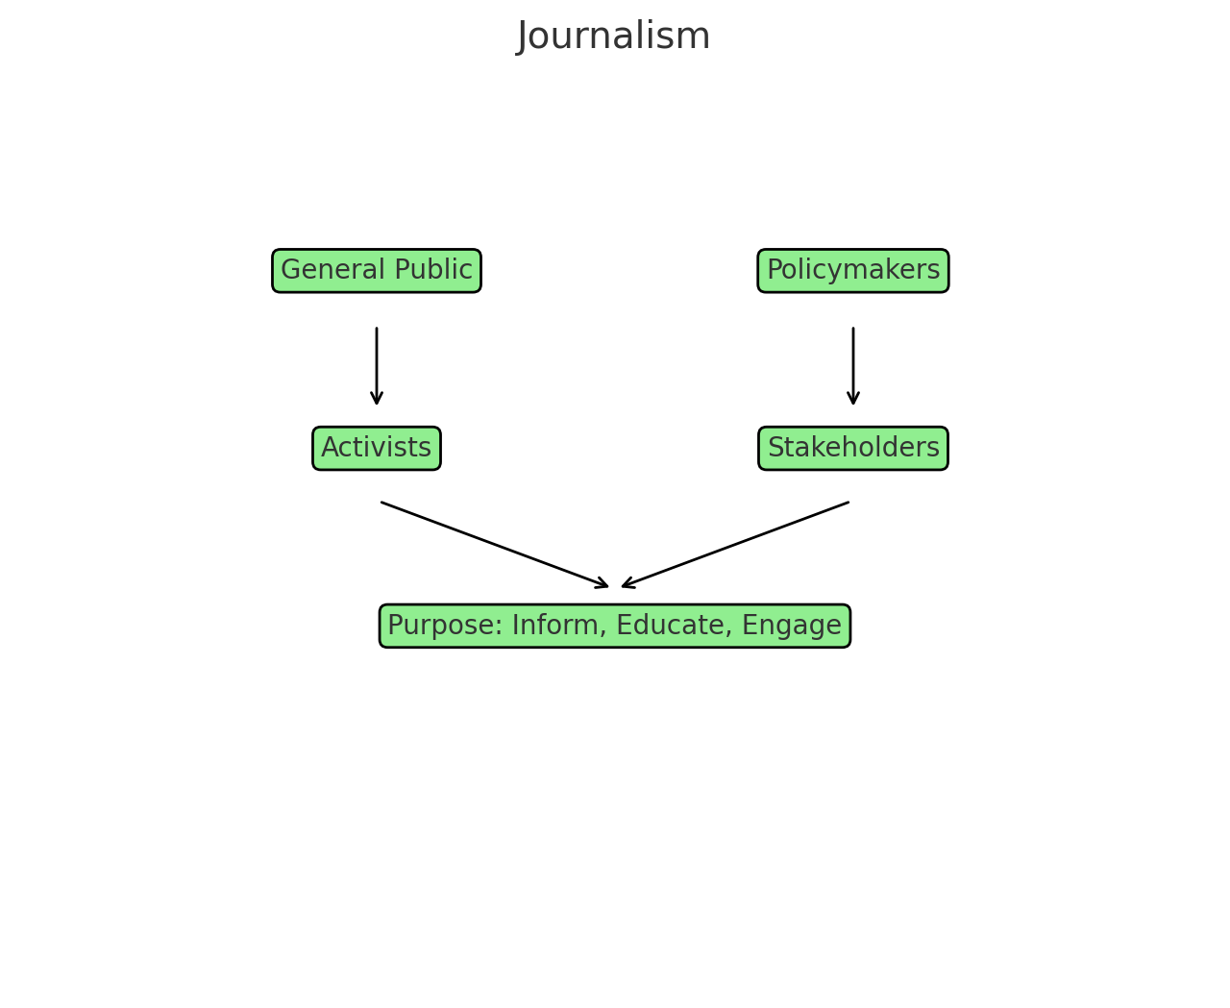

Slide 10
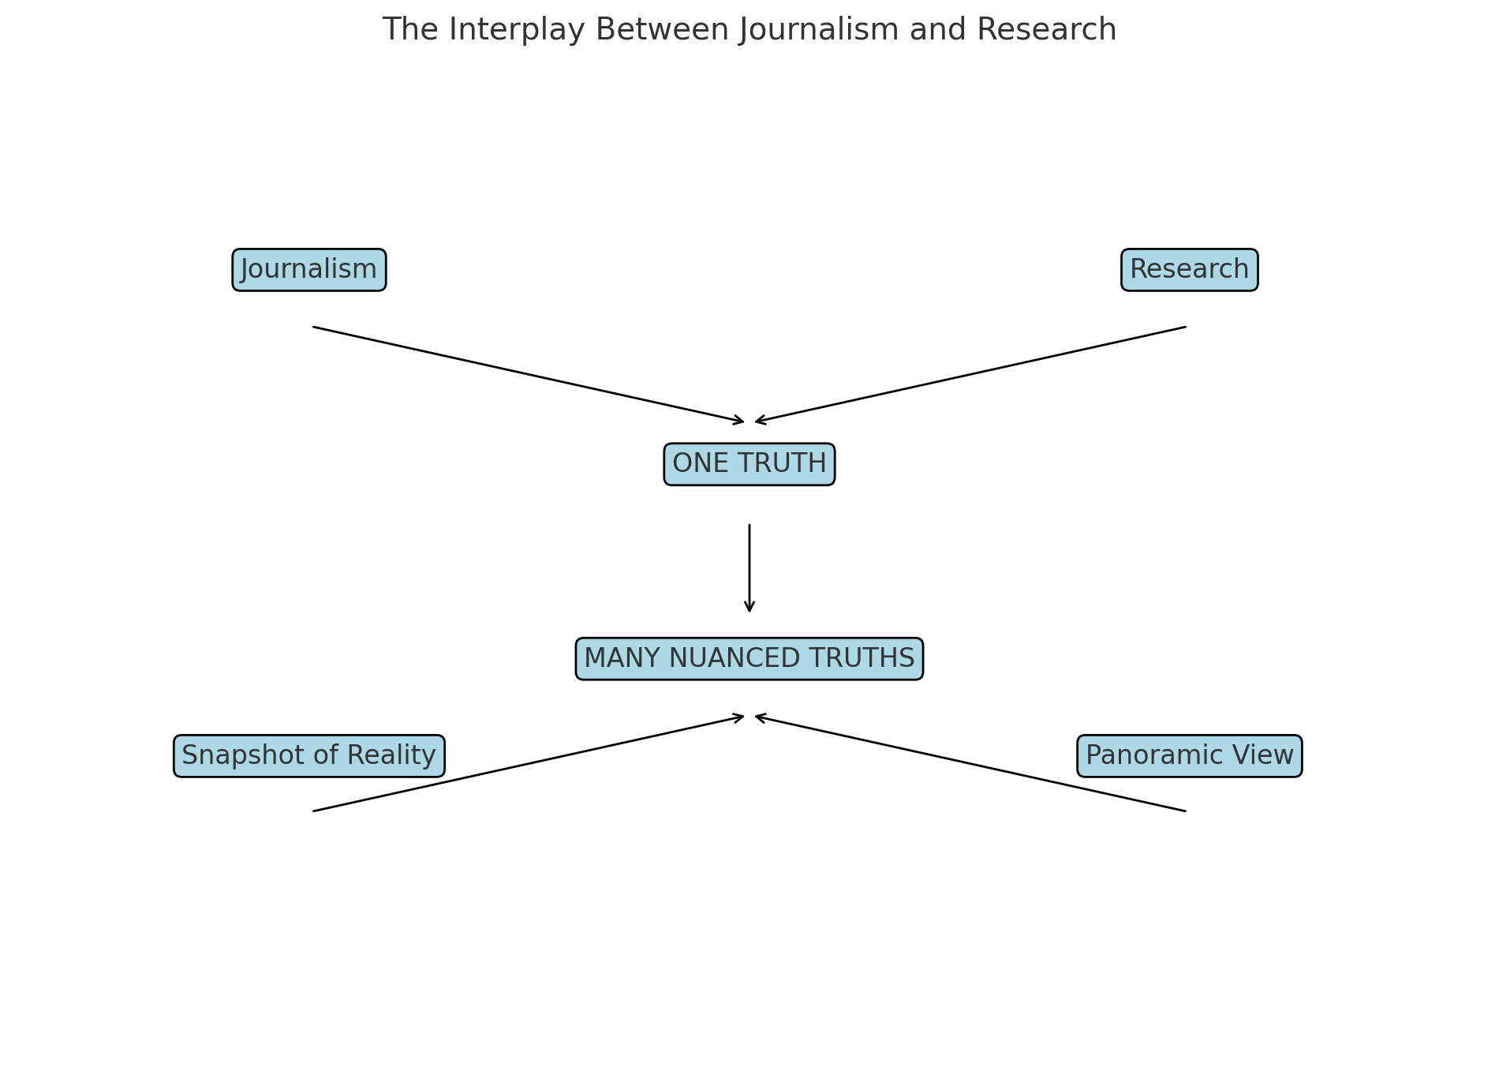

Slide 11
Answers:
1. How do Trump’s foreign policy goals align with realist and liberalist paradigms in international relations theory? (A)
2. Does Trump have a specific timeline to end global wars? (B)
3. What are the structural and systemic barriers to achieving world peace? (A)
4. What steps has Trump taken so far toward ending ongoing conflicts? (B)
5. How have historical precedents of similar political promises fared in achieving global peace? (A)
6. How are international leaders responding to Trump’s peace proposals? (B)

Slide 12
Why So?
1. How do Trump’s foreign policy goals align with realist and liberalist paradigms in international relations theory? (A)
-This question analyzes theories, making it academic.
2. Does Trump have a specific timeline to end global wars? (B)
-This focuses on a direct, time-sensitive issue, making it journalistic.
3. What are the structural and systemic barriers to achieving world peace? (A)
-This question seeks broad patterns and deeper insights, fitting academic inquiry.

Slide 13
Why So? (continued)
4. What steps has Trump taken so far toward ending ongoing conflicts? (B)
-This is action-oriented and about immediate events, making it journalistic.
5. How have historical precedents of similar political promises fared in achieving global peace? (A)
-This past events to draw insights, a hallmark of academic research. examines
6. How are international leaders responding to Trump’s peace proposals? (B)
-This focuses on current reactions, characteristic of journalism.

Slide 14
References
1. Booth, W. C., Colomb, G. G., & Williams, J. M. (2008). The Craft of Research.
2. Creswell, J. W., & Poth, C. N. (2017). Qualitative Inquiry and Research Design.
3. Falk, R., & Tilley, V. (2017). Israeli Practices Towards the Palestinian People and the Question of Apartheid.
4. Galtung, J. (1969). “Violence, Peace, and Peace Research.” Journal of Peace Research.
5. Goldstein, J. S. (2011). Winning the War on War.
6. Kovach, B., & Rosenstiel, T. (2021). The Elements of Journalism.
7. Mearsheimer, J. J. (2001). The Tragedy of Great Power Politics.
8. Tuchman, G. (1978). Making News: A Study in the Construction of Reality.
9. Waltz, K. N. (1979). Theory of International Politics.

