Slide 1

Publishing in Social Sciences
South Coast Doctoral Training Partnership (ESRC)
Dina Koutsomichali June 2023

Slide 2

What we are going to cover
The OA labyrinth
  OA characteristics, triggers for change, recent developments, issues for writers, issues for institutions and readers.
Institutional and community responses
Innovative developments
Tools that can help

Slide 3

Open Access characteristics for books, journals, data
OA characteristics
Digital
Accessible/discoverable
Free of charge
Free of most copyright
Free of licensing restrictions

Slide 4
Triggers for change
National and international bodies and frameworks (i.e. research consortiums like cOAlition S, the REF)
Funders’ requirements and policies (i.e. UKRI)
Publishers (i.e. APCs, embargos, licences, sales, pricing)

Slide 5
Recent developments
UKRI updated policy:
Immediate OA (within one month of online publication), for peer-reviewed research articles and conference proceedings submitted for publication from 1st April 2022.
New requirement for monographs, book chapters and edited collections published from 1st Jan 2024 to be made open access within 12 months of publication (1st Jan 2025).
US Office of Science and Technology Policy (OSTP) change of policy:
They updated their guidance to make publications and research funded by taxpayers publicly accessible without an embargo or cost as soon as possible.
All policies to be updated and fully implemented by 31st Dec 2025.
REF2029:
The REF 2029 OA Policy consultation is currently underway. Closes 17th June 2024. Report expected in late summer/autumn 2024.
Aims to embed progress for OA submission for journal publications and introduces an OA requirement for long form (book chapters and books).

Slide 6
UKRI: what do the changes mean?
The Final Version of Record or Author’s Accepted Manuscript must be free to view and download via an online publication platform, publisher’s website, or institutional or subject repository within a maximum of 12 months of publication.
  Most HSS publishers have an embargo of 24 months.
Images, illustrations, tables, and other supporting content should be included in the open access version, where possible.
Licence: CC-BY (but may consider CC-BY-ND). Must include a Data Access Statement explaining where and under what conditions the data can be accessed even when there are no data associated or they are inaccessible. It is possible to have a variety of licences, i.e. one for the text and another one for the images.
UKRI will review the policy in 2026 but may make changes in the meantime if necessary.

Slide 7
Exceptions to the UKRI policy
The contract with the publisher was signed before 1st Jan 2024 and does not enable OA in compliance with UKRI policy.
The only appropriate publisher is unable to offer an OA option that complies with UKRI policy.
OA is encouraged but not required if a monograph, book chapter or edited collection is the outcome of a UKRI training grant.
Reuse permissions for third-party materials cannot be obtained and there is no suitable alternative to enable OA publication.

Slide 8
Funding
There is a£3.5million fund available to contribute towards the cost of publishing OA.
Researchers will need to include publication costs in their UKRI submission. VAT is not charged in the UK for these models but where VAT is charged, this needs to be included in the maximum funding level.
Different maximum permitted limits:
  £10,000 for monographs, edited collections
  £1,000 for book chapters
  £6,000 for non-book processing charge models. These are also referred to as diamond, collective or subscribe to models.
  £2,0000 for third-party materials’ costs but within the above maximum limits.
Claiming from the UKRI OA fund needs to happen very early on, before committing with a publisher. University research officers can advise on the process.
Notes:
Stage 1 online: Intention to claim from the fund. Requires a lot of information, An estimate can be used. UKRI say they will process within 10 days.

Slide 9
The Publishers: Market report
Publishers have drastically reduced production and have become more selective.
Impacts from academic markets are negatively affecting the publishing competitors that serve these markets.
In 2023, the Social Science and Humanities market has only gained 0.7% over 2022 and it is expected that growth will be hindered in 2023-25. Books and journals have declined since 2019 esp. in print but online content is expected to grow.
Global Social Sciences & Humanities Publishing 2023-2027 - The Freedonia Group

Slide 10

Issues for writers
Where to publish
Funding
Compliance
Quality
Security

Slide 11
Issues for institutions and readers
Affordability: Double-dipping, cost of subscriptions for journals, cost of purchasing ebooks and eTextbooks.
Discoverability of OA publications and data.
Monograph publishing deals require different infrastructure in terms of publishing deals to that of journal subscriptions.

Slide 12
Institutional and community responses
Jisc frameworks and deals for journals and monographs
University Repositories and Presses
Ebook SOS movement
Open Book projects like the Open Book Futures consortium
Proliferation of Open Access models from Green and Gold to Diamond

Slide 13
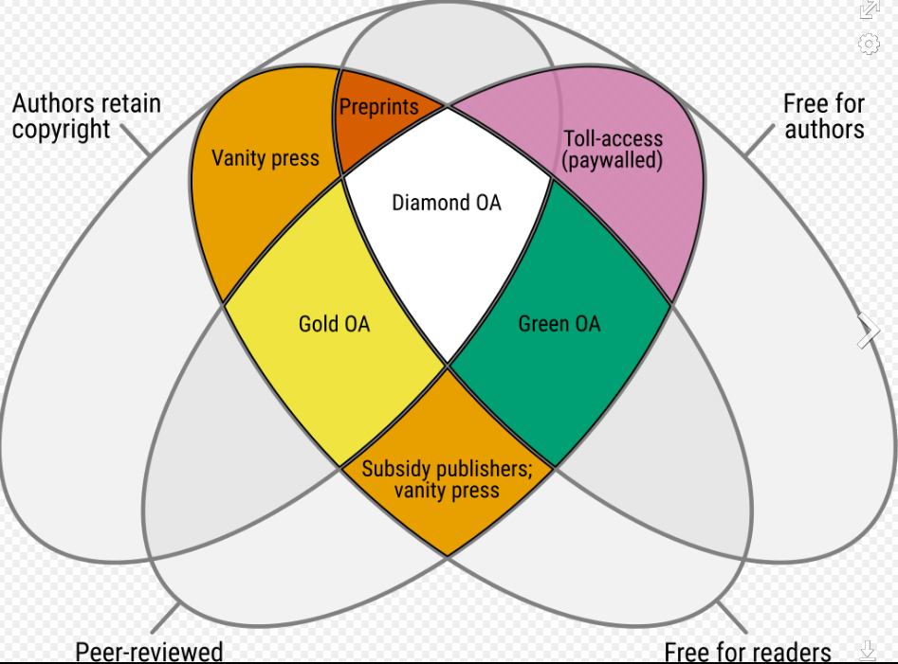
Open Access models
Diamond: Not-for-profit publishing practice.
Community-driven, academic-led, academic owned publishing initiatives.
Diamond open access venn diagram [en SVG] (figshare.com)by Jamie Farquharson.

Slide 14
Innovative developments and challenges
Innovative developments
Self-publishing that includes Open Access
Pre-print, working papers and research data servers, i.e. SocArXiv, SSRN
Smaller independent publishers, community publishers, collectives
Octopus
Challenges
Discoverability
Infrastructure
Journal security
Rights retention (licence)
Quality/assessment models
Funders’ requirements
Impact
Notes:
Pre-print: research articles, reports, etc., before they have been accepted for publication, formal peer review.

Slide 15
Journal security: Paper mills
COPE, the Committee on Publication of Ethics, describes them as:
“profit oriented, unofficial and potentially illegal organizations that produce and sell fraudulent manuscripts that seem to resemble genuine research.” Guest Post - Addressing Paper Mills and a Way Forward for Journal Security - The Scholarly Kitchen (sspnet.org)
Manipulate identities
Fabricate content
Led to some Willey journals losing their Web of Science impact factors

Slide 16

Octopus: A new ‘primary research record’ for recording and appraising research ‘as it happens’.
Designed to make primary research openly available to all.
Recording your work on Octopus is different from publishing a paper. There are eight publication types that are aligned with the research process and designed to help researchers of all types share their work and be recognised for it.
The publication types are:
Problem
Hypothesis/rationale
Methods/protocol
Data/results
Analysis
Interpretation
Real-world implementation
Peer review
These elements are linked together to form chains of collaborative work.

Slide 17
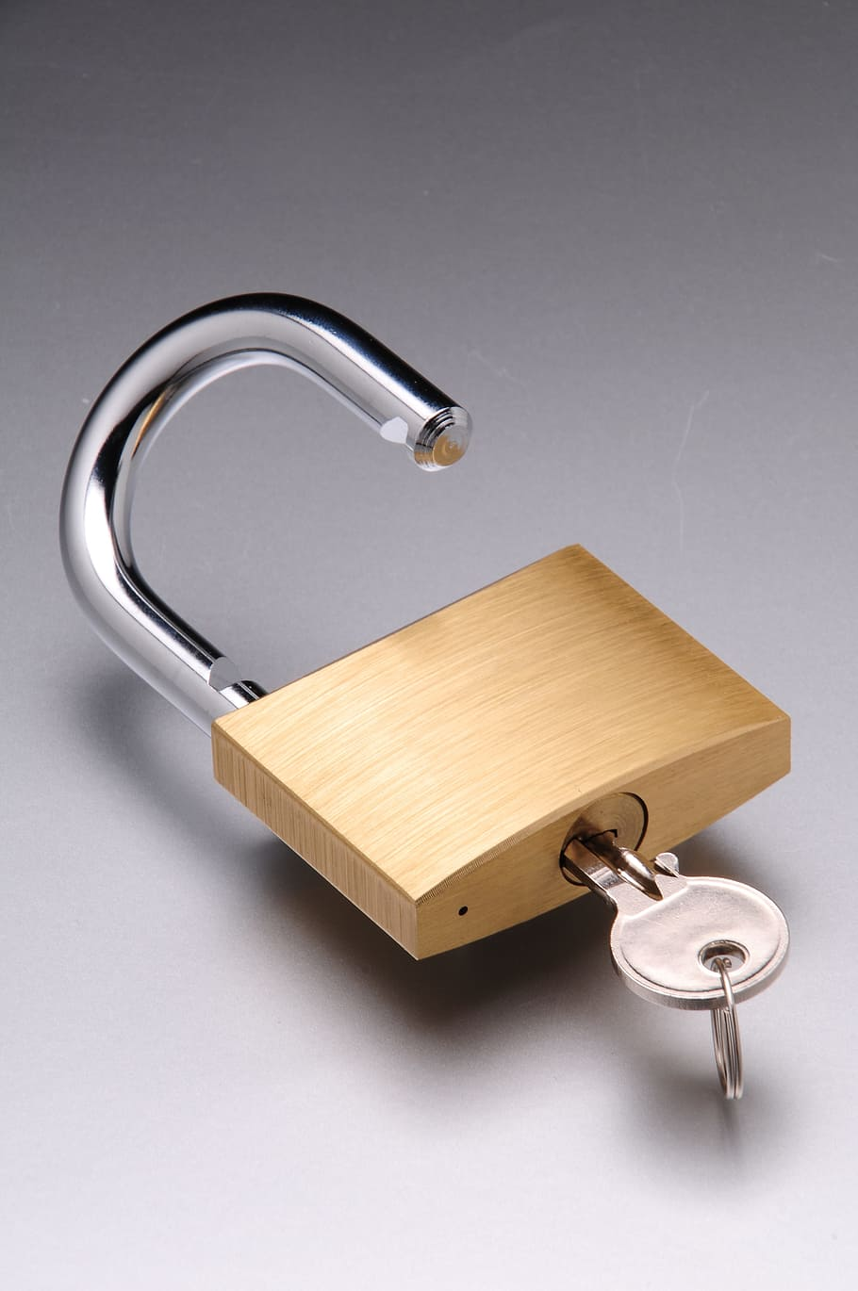
Tools that can help
What you need to know
Think. Check. Submit It has checklists to help researchers identify trusted journals and publishers for their research.
Journal OA policies
Sherpa Services is an online resource which collects information on publisher open access policies and provides summaries of publisher copyright and open access archiving policies.
Funder’s Requirements
Sherpa FACT is a Funders and Authors Compliance Tool. It provides clear guidance on whether a journal complies with a funder's open access policy.
OA Books Toolkit
Sherpa for books offers an overview of publishers’ book policies to help authors and research organisations make informed decisions on OA publishing and meeting funders’ guidelines.
Home | OA Books Toolkit (oabooks-toolkit.org) to help book authors understand open access book publishing and to increase trust in open access books. Has useful info on How to choose a publisher for your open access book | OA Books Toolkit (oabooks-toolkit.org).
Open Access Platforms
OAPEN: Online Library and Publication Platform | OAPEN
DOAB: DOAB | Directory of Open Access Books (doabooks.org)
SSOAR: Social Science Open Access Repository
DOAJ: Directory of Open Access Journals
OpenDOAR: Directory of OA repositories

Slide 18
Useful links
Alternatives to mainstream publishing within and beyond academia | Ephemeral Journal (ephemerajournal.org)
Campaign to investigate the Library ebook market – Fighting for fair e-lending rights (academicebookinvestigation.org)
Funder's Requirements University of Brighton (sharepoint.com)
Sanctioning of 50 journals raises concerns over special issues in ‘mega-journals’ | News | Chemistry
Global Social Sciences & Humanities Publishing 2023-2027 - The Freedonia Group
Guest Post - Addressing Paper Mills and a Way Forward for Journal Security - The Scholarly Kitchen (sspnet.org)
Libraries call on academic colleagues to help shift to full open academic publishing | SCONUL
Octopus: creating a new primary research record for science – Jisc
OSTP Issues Guidance to Make Federally Funded Research Freely Available Without Delay | OSTP | The White House
Rights retention: publisher responses to the University's pilot - Unlocking Research (cam.ac.uk)
SocArXiv Papers (osf.io)
‘Too greedy’: mass walkout at global science journal over ‘unethical’ fees | Peer review and scientific publishing | The Guardian
UKRI announces new Open Access Policy – UKRI
UKRI and Pre-prints

