Slide 1
Training needs analysis – the procedural and the meaningful
Melanie Nind, SCDTP deputy director, M.A.Nind@soton.ac.uk
22 March 2022
Notes:
Date: 22nd March 2022, Time: 2pm – 4pm, Location: Building 2, Rm 5053

Slide 2
Training needs analysis – the procedural
Notes:
Date: 22nd March 2022, Time: 2pm – 4pm, Location: Building 2, Rm 5053

Slide 3
What is the TNA? Discuss
What do you know already?
What do you want to know?
Notes:
DISCUSS

Slide 4
The ESRC view
‘A rigorous annual training needs analysis (TNA) must be undertaken for all ESRC-funded students. This will ensure that students receive a progressive training programme that addresses both the depth and the breadth of the training they require.’
(ESRC Postgraduate Training and Development Guidelines Second Edition 2015)

Slide 5
‘all ESRC-funded students undertake a detailed Training Needs Analysis (TNA) at the start of their studentship, which is reviewed annually. The ESRC monitor this requirement by undertaking a sample check of TNAs. The TNA is designed to ensure students, with the support of their supervisors, develop a progressive programme that delivers the depth and breadth of training needed, given their existing knowledge and skill levels.’
(Tazzyman et al 2021 Review of the PhD in the Social Sciences)

Slide 6
Transferable skills
‘Students do not always recognise the importance of transferable skills training during the doctoral experience and take-up of non-mandated skills training opportunities is mixed. Undertaking an effective individual Training Needs Analysis (TNA) at the start of a student’s studies, with regular reviews throughout their programme of study, helps to ensure students receive tailored provision that they value.’
(Tazzyman et al 2021 Review of the PhD in the Social Sciences)

Slide 7
Two audiences – one partnership
Us – the DTP and the doctoral programme
So we know what gaps we need to fill
So we can create SIGs etc
So we can be responsive
You – the person in the driving seat
So you aren’t just a passenger
So you grow
So you succeed

Slide 8
Training needs analysis – the meaningful
Notes:
Date: 22nd March 2022, Time: 2pm – 4pm, Location: Building 2, Rm 5053

Slide 9
Models of learning
Transmission/banking model
Social construction/constructivism
Like Dickens in Hard Times: ‘Now, what I want is, facts … Facts alone are wanted in life. Children are ‘little vessels … ready to have imperial gallons of facts poured into them until they were full to the brim.’
We don’t just acquire knowledge & skills through training, we construct new understandings, knowledge & skills through experience, which is often socially mediated, and integrated with prior knowledge and experience in active processes of making meaning

Slide 10
A meaningful approach Can you add to the tiles?
What skills and knowledge do you bring?
What skills and knowledge do you need?
How do you like to learn?
How will you build on your foundations?
How will you fill the gaps?
What is your plan for learning?
How will you keep this dynamic?
Notes:
CAN YOU ADD TO THE TILES?

Slide 11
Meaningful not tick box
Real reflection
Real planning
Real dialogue
Undertake training activity
Real reflection
Real planning
Real dialogue
Undertake training activity

Slide 12
Recognising prior learning Pair exercise 1
Picture yourself
Your masters
Your work
Volunteering
Describe a prior experience
Identify the learning within it
Name and reflect on the learning
Was it good learning this way?
How skilled or knowledgeable did you get?
How will you use the learning in your PhD?
Think discipline/topic specific, and transferable skills…
Notes:
EXERCISE

Slide 13
Planning future learning Pair exercise 2
Imagine yourself in 4 years time
What will you be doing?
What skills and knowledge will you have?
How will you be using them?
Notes:
EXERCISE

Slide 14
Envisaging future needs 1
Thinking about all the needs can be overwhelming, so we chunk it up, what is urgent and what can wait, plan for year 1, year 2 etc or:
Headwork
Datawork
Textwork
Notes:
3 groups

Slide 15
Envisaging future needs 2
Q. How do you know what you will need?
A. Reflection & dialogue
Q. How do know where you have skills already?
A. Self-appraisal & dialogue
Q. How do you know what you don’t know?
A. Dialogue!
Notes:
Pairs & snowball

Slide 16
Other tools to aid dialogue Exercise 3: Choose 1
Walk & talk
Journaling
Narrative CV
Diagnostic tools
Your own

Slide 17
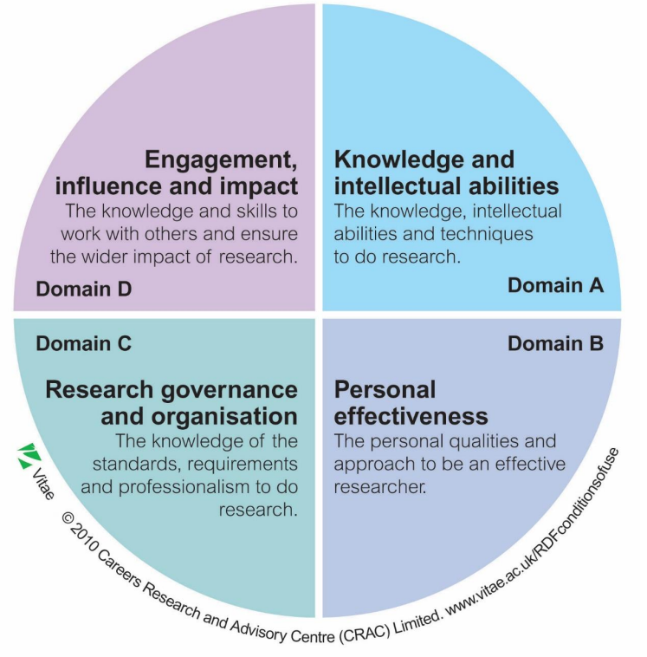
Vitae: Researcher Development Framework

Slide 18
Vitae
Notes:
Pick a domain – look back, look forward

Slide 19
1. Support
Supervisors
Librarians
Careers
Employers
Postdoc fellows
Alumni
PEERS

Slide 20
2. Asking the right questions
What assumptions are we each making?
What might push me out of my comfort zone?
What do I need?

Slide 21
3. Finding training to meet or discover needs
Horizon-scanning
Where do you look?
In-house
Nationally
Internationally
What if you can’t find what you need?
Notes:
Uni, SCDTP, pathway, research centre, grad school, doctoral college
National organization, BERA, NCRM
International organization, WCQR etc

Slide 22
Useful reading
Nind, M., Holmes, M., Insenga, M., Lewthwaite, S., & Sutton, C. (2020). Student perspectives on learning research methods in the social sciences, Teaching in Higher Education, 25, 797-811.

Slide 23
Where to look Exercise 4 – explore and add to the list
https://www.ncrm.ac.uk/training/
https://www.ncrm.ac.uk/research/socscicovid19/
https://sotonac.sharepoint.com/teams/PGRDevelopmentHub
https://www.port.ac.uk/study/postgraduate-research/graduate-school/graduate-school-development-programme-and-other-researcher-training
https://www.bera.ac.uk/events
https://www.researchgate.net/project/World-Conference-on-Qualitative-Research

Slide 24
Exercise 5 Think out of the box
Brainstorm alternatives to ‘take a course on it’ – can you get to 10? 20?
read a book
watch a video
shadow someone
…
…
Notes:
, ask a peer, do a lit search, go to the grey lit, find a mentor)

Slide 25
An effective TNA
Helps you to zoom in on making real what matters most and to zoom out for an overview
Gets the procedural and the meaningful to meet
Helps you to plan
Helps those supporting you to plan
And brings you into dialogue

Slide 26
For a copy of this presentation, go to:
Training Resources - South Coast DTP

