Slide 1

Researchfish – Reporting the outputs and outcomes of your SCDTP research
What, who, why, when, how?
7 March 2022

Slide 2
What is Researchfish?
A central repository to hold all outputs resulting from funding given by Research Councils and other agencies

Slide 3
Who needs to act?
Those of us with UKRI funding
We know we are included when we get an email (but do check spam folders)
This is mandatory for staff and was mandatory for doctoral researchers too
Since Covid-19 it has become optional

Slide 4
Why is it important?
Helps UKRI understand what has changed as a result of the funding support you have received
Helps them demonstrate the value and impact of publicly funded research and training, which helps to justify the spending
be transparent about what funding delivers
make research more visible and open to the public

Slide 5
When?
Now!
The completion of the online record happens every year during the award and for 3 years afterwards
The window has opened and runs to 17th March

Slide 6

The guidance says
you will usually need to report outcomes from the third year of your studentship and for three years after it ends
optional for students to report in 2022 due to the ongoing disruption and delays caused by the COVID-19 pandemic. However, we are encouraging students who are able to do so to make a submission. This is very valuable in helping us understand the outcomes of students’ research and the impact of our training awards, in particular, the impact the pandemic has had on student outcomes.

Slide 7
What needs to be reported?
Anything that is as a result of the funding
Outputs e.g. publications, exhibitions, new research tools
Outcomes e.g new or improved products, processes or public policies.
Impact e.g. changes that benefit the economy, society, culture, health, the environment or quality of life
Key findings

Slide 8
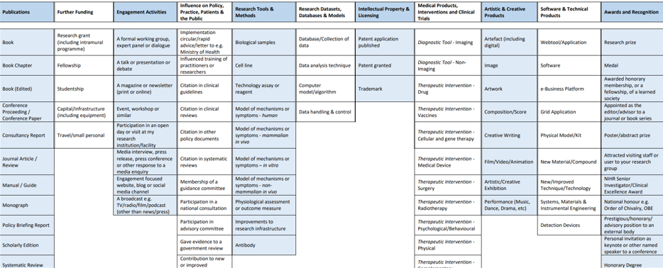
You have lots to choose from!

Slide 9
Most relevant might be
Publications – including journal articles, conference proceedings, thesis!
Engagement activities – including presentations, magazine articles, podcasts
Awards and recognition – including prizes

Slide 10
Key findings
Main, high-level results from the award
What you have you discovered or developed
The main academic achievements
New knowledge you have generated
Or new or improved research methods
New research questions you have opened up

Slide 11
How?
Researchfish will send you an email. Check your junk folder if you have not received anything.
Click on the link in the email to confirm the award is yours. You must do this to link your award to your Researchfish account.
If you do not already have a Researchfish account, you’ll be asked to create one.

Slide 12
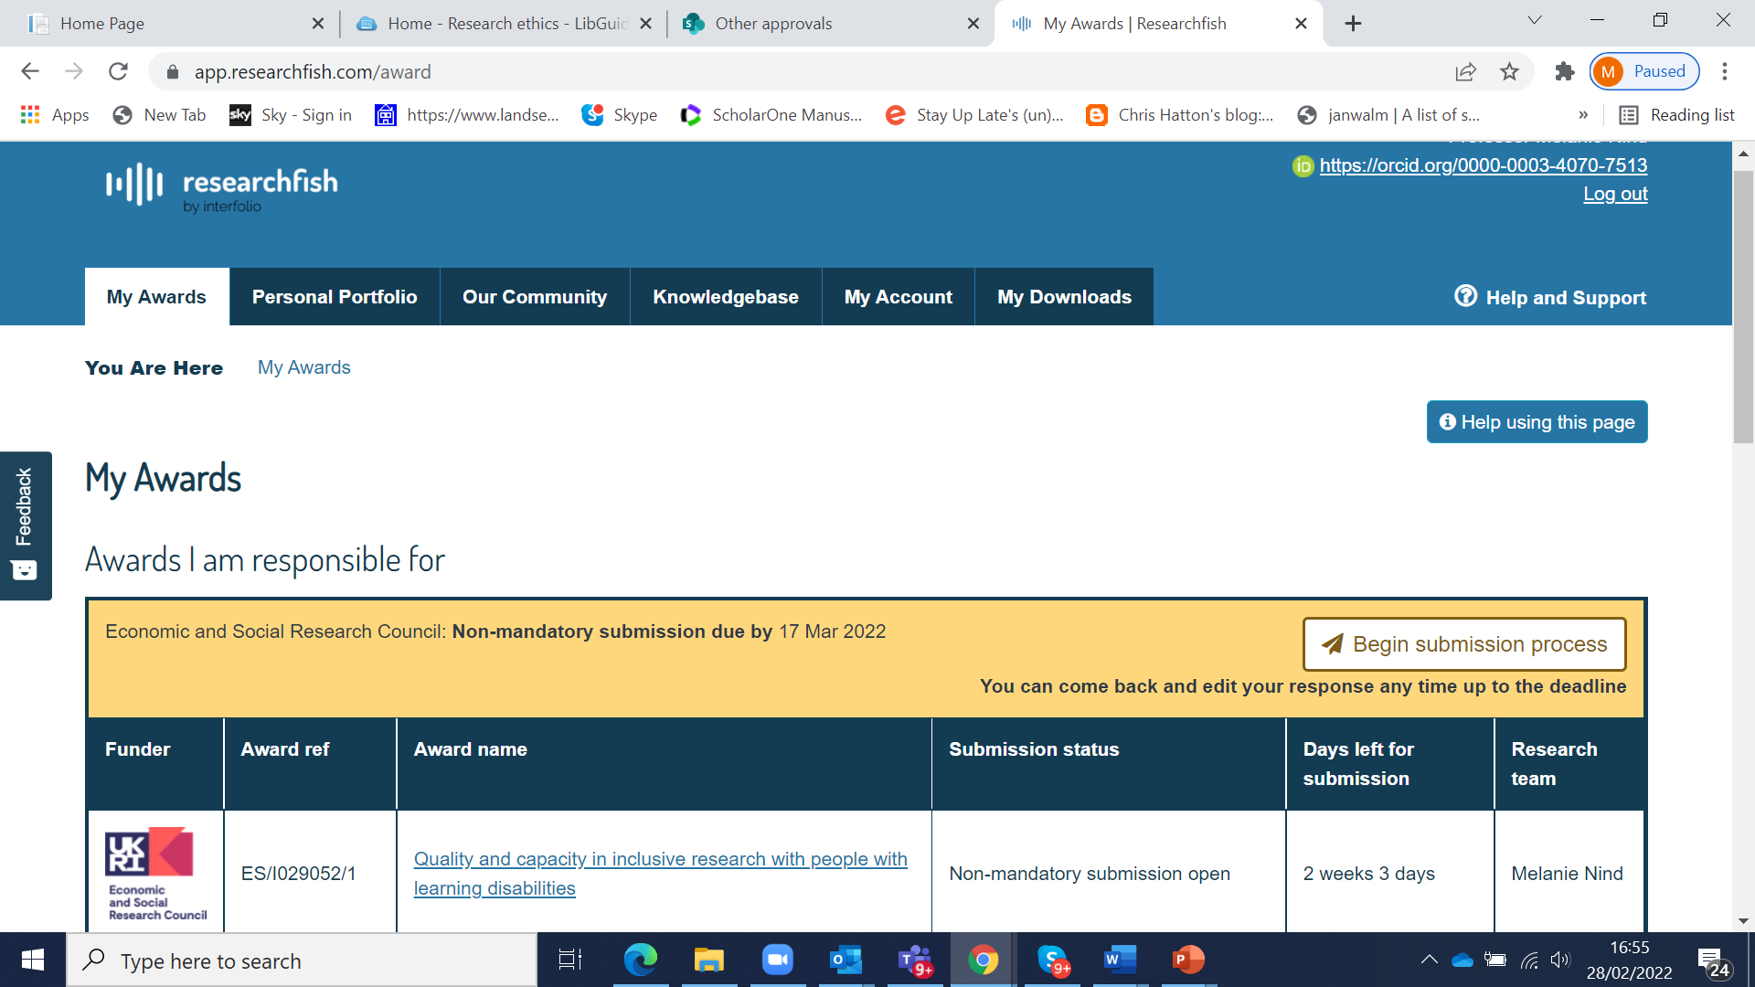
You will get a screen like this

Slide 13
https://userguide.researchfish.com/

Slide 14
Support
Technical questions email: support@researchfish.com or use the Researchfish live chat service.
Procedural questions about reporting requirements
see frequently asked questions for grants on Researchfish
Ask UKRI a question about reporting your research outcomes, email: researchoutcomes@funding.ukri.org

Slide 15

Photo by Ana Municio on Unsplash

